Slide 1

Session 10
Linear Programming – Transportation
Big Data and Analytics
Topic 10: Association Rules
We will wait for 5 to 10 mins for everyone to join

Slide 2

Recap
Linear Programming – Transportation
What we discussed last week?

Slide 3
Recap: Clustering
Goal of Clustering
Given a set of data points, each described by a set of attributes, find clusters such that:
  Inter-cluster similarity is
  maximised
  Intra-cluster similarity is
  minimised
Requires the definition of a similarity measure
  Distance
F1
x
x
x
x
x
x
x
x
xx
x
x
x
x
x
x
xx
x
F2

Slide 4
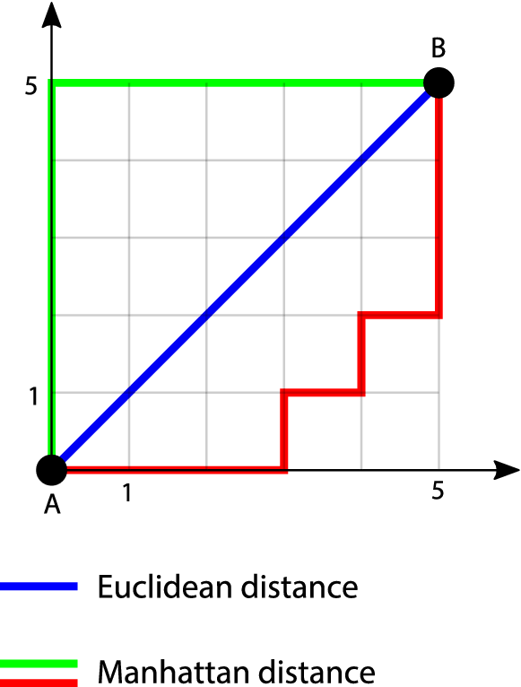
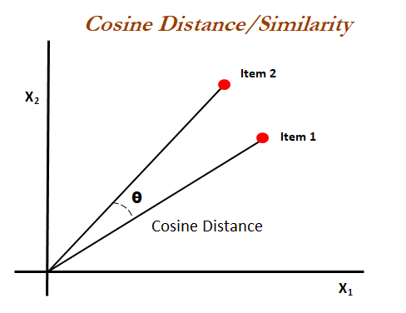
Recap: Clustering
  Distance
There are various techniques to measure similarity or dissimilarity between data objects.
Common methods include:
the Euclidean distance,
Manhattan distance, and
cosine similarity for continuous data.
For categorical data, methods like:
the Jaccard coefficient or
Hamming distance
might be used.

Slide 5
Recap: Clustering
The Four Steps of Cluster Analysis
Feature Selection or Extraction
  identifying the most relevant attributes of our data
    Filter Methods (e.g., Chi-squared test, Information Gain)
    Wrapper Methods (e.g., Recursive Feature Elimination)
    Embedded Methods (e.g., LASSO, Decision Trees)
    Dimensionality Reduction (e.g., PCA)
Clustering Algorithm Design or Selection
  Partitional algorithms: Construct various partitions and then evaluate them by some criterion
  Hierarchical algorithms: Create a hierarchical decomposition of the set of objects using some criterion
Cluster Validation
  Evaluation Metrics: Silhouette Coefficient, Davies-Bouldin Index
Results Interpretation
  Understanding and Making Sense of Clusters
  Practical Implications of Cluster Analysis
  Visualization Techniques

Slide 6
Association Rules
Association rule mining is a technique used to uncover hidden relationships between variables in large datasets. It is a popular method in data mining and machine learning and has a wide range of applications in various fields, such as market basket analysis, customer segmentation, and fraud detection.

Slide 7
Association Rules
For example, consider a dataset of transactions at a grocery store.
Association rule mining could be used to identify relationships between items that are frequently purchased together.
For example, the rule "If a customer buys bread, they are also likely to buy milk" is an association rule that could be mined from this data set.
We can use such rules to inform decisions about store layout, product placement, and marketing efforts.
Association rule mining typically involves using algorithms to analyse the data and identify the relationships.
These algorithms can be based on statistical methods or machine learning techniques.
The resulting rules are often expressed in the form of "if-then" statements, where the "if" part represents the antecedent (the condition being tested) and the "then" part represents the consequent (the outcome that occurs if the condition is met).

Slide 8
Association Rules
Given a set of transactions, find rules that will predict the occurrence of an item based on the occurrences of other items in the transaction
Market-Basket transactions
Example of Association Rules
{Diaper} → {Beer},
{Milk, Bread} → {Eggs,Coke},
{Beer, Bread} → {Milk},
Implication means co-occurrence, not causality!

Slide 9
Association Rules
Applications:
Market Basket Analysis
association rule mining is used in retail to understand customer buying habits.
Healthcare and Medicine
application in drug discovery, understanding patient patterns, and disease co-occurrence.
Web Usage Mining
its use in understanding user behaviour on websites.
Fraud Detection and Security
detecting suspicious patterns in banking and security systems.
Recommendation Systems
association rules can be used in recommending products or content to users.
Notes:
Example1: Identifying products that are frequently bought together.
Example2: Finding associations between patient characteristics and specific diseases.
Example3:: Identifying sequences of web pages visited frequently together.
Example4: Identifying unusual combinations of transactions that could indicate fraud.
Example5: Online platforms suggesting products or movies based on user's past behaviour.

Slide 10
Association Rules
Itemset
  A collection of one or more items
    Example: {Milk, Bread, Diaper}
  k-itemset
    An itemset that contains k items
Support count (σ)
  Frequency of occurrence of an itemset
  E.g. σ({Milk, Bread,Diaper}) = 2
Support
  Fraction of transactions that contain an itemset
  E.g. s({Milk, Bread, Diaper}) = 2/5
Frequent Itemset
  An itemset whose support is greater than or equal to a minsup threshold (minimal support used as a threshold. )

Slide 11
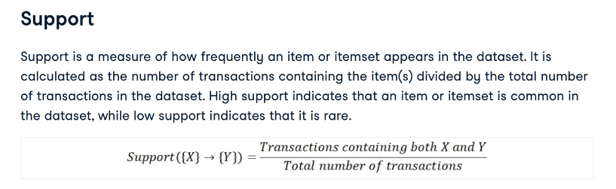
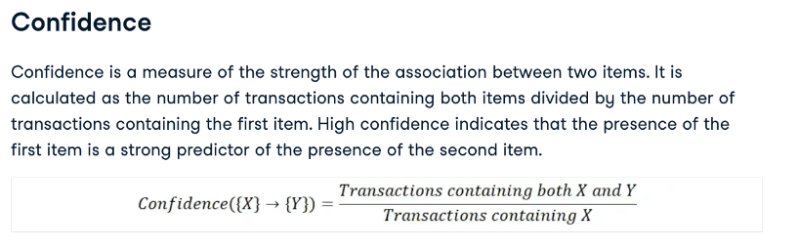
Rule Evaluation Metrics- Association Rules
Notes:
Support: Fraction of transactions containing the itemsets in both X and Y.
Support(X→Y)=Total number of transactions/Number of transactions with (X∪Y)​
Confidence: Probability that transactions with X also include Y.
$\text{Confidence}\left(X→Y\right)=\frac{\text{Support}\left(X∪Y\right)}{\text{Support}\left(X\right)}$

Slide 12
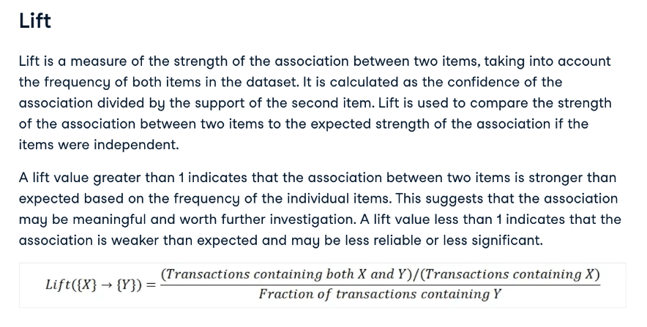
Association Rules
Notes:
Lift: The ratio of observed support to that expected if X and Y were independent.
$$\text{Lift}\left(X→Y\right)=\frac{\text{Confidence}\left(X→Y\right)}{\text{Support}\left(Y\right)}$$
Lift > 1 implies a positive association — items occur together more than expected.
Lift = 1 implies independence.
Lift < 1 implies a negative association.

Slide 13
Association Rules
Association Rule
  An implication expression of the form X → Y, where X and Y are itemsets
  Example:
  {Milk, Diaper} → {Beer}
Rule Evaluation Metrics
  Support (s)
    Fraction of transactions that contain both X and Y
  Confidence (c)
    Measures how often items in Y
    appear in transactions that
    contain X
Example:

Slide 14
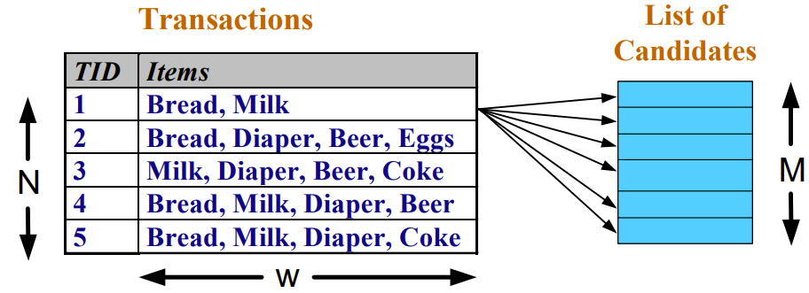
Association Rules
Association Rule Mining Task
Given a set of transactions T, the goal of association rule mining is to find all rules having
  support ≥ minsup threshold
  confidence ≥ minconf threshold
Frequent Itemset Generation
Brute-force approach:
  List all possible association rules
  Compute the support and confidence for each rule
  Prune rules that fail the minsup and minconf thresholds
  ⇒ Computationally prohibitive!

Slide 15
Association Rules
Example of Rules:
{Milk,Diaper} → {Beer} (s=0.4, c=0.67)
{Milk,Beer} → {Diaper} (s=0.4, c=1.0)
{Diaper,Beer} → {Milk} (s=0.4, c=0.67)
{Beer} → {Milk,Diaper} (s=0.4, c=0.67)
{Diaper} → {Milk,Beer} (s=0.4, c=0.5)
{Milk} → {Diaper,Beer} (s=0.4, c=0.5)
Observations:
All the above rules are binary partitions of the same itemset:
{Milk, Diaper, Beer}
Rules originating from the same itemset have identical support but can have different confidence
Thus, we may decouple the support and confidence requirements
Example:

Slide 16
Association Rules Algorithms
Apriori Algorithm
The apriori algorithm has become one of the most widely used algorithms for frequent itemset mining and association rule learning. It has been applied to a variety of applications, including market basket analysis, recommendation systems, and fraud detection, and has inspired the development of many other algorithms for similar tasks.
FP-Growth algorithm
The FP-Growth (Frequent Pattern Growth) algorithm is a popular algorithm for association rule mining. It works by constructing a tree-like structure called a FP-tree, which encodes the frequent itemsets in the dataset. The FP-tree is then used to generate association rules in a similar manner to the Apriori algorithm. The FP-Growth algorithm is generally faster than the Apriori algorithm, especially for large datasets.
ECLAT algorithm
The ECLAT (Equivalence Class Clustering and bottom-up Lattice Traversal) algorithm is a variation of the Apriori algorithm that uses a top-down approach rather than a bottom-up approach. It works by dividing the items into equivalence classes based on their support (the number of transactions in which they appear). The association rules are then generated by combining these equivalence classes in a lattice-like structure. It is a more efficient and scalable version of the Apriori algorithm.

Slide 17
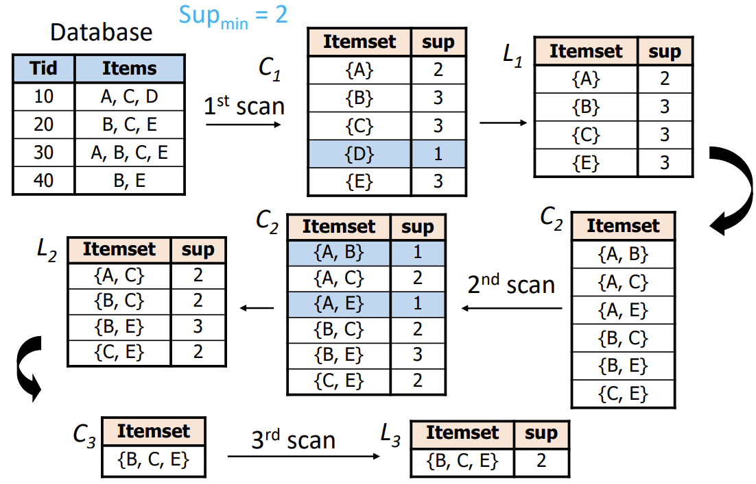
The Apriori Algorithm—An Example

Slide 18
Association Rules
FP-growth Algorithm
A video for more detailed information about association rules
https://www.youtube.com/watch?v=3LEUCV83OWM
Notes:
resource:https://www.youtube.com/watch?v=XW191kj4wW4

Slide 19
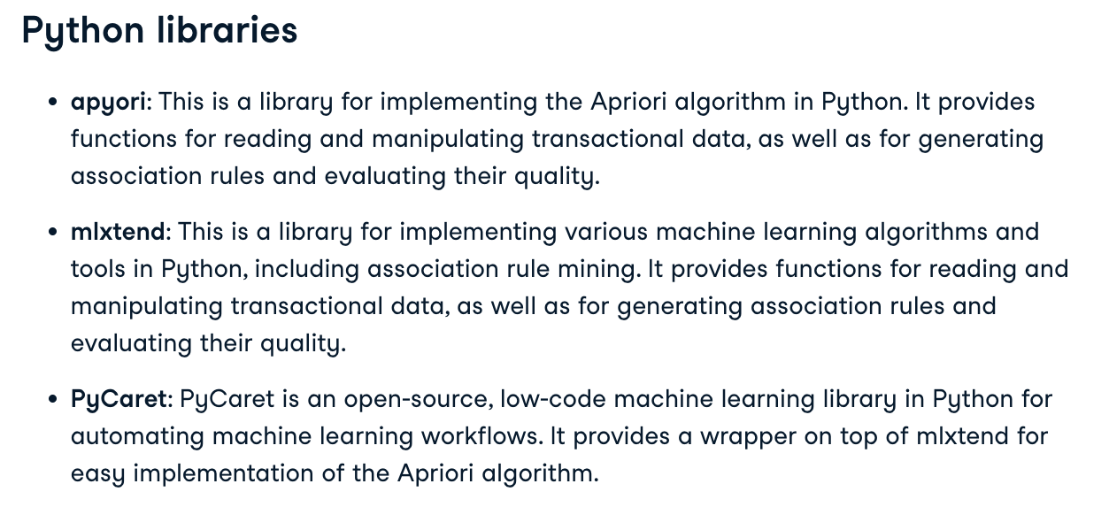
Association Rules
FP-growth Algorithm

Slide 20
Questions?

